Slide 1

SOCIAL ENGINEERING AND PHISHING:
A Cyber Attack

Slide 2

Introduction to Social Engineering
Social engineering refers to the manipulation of individuals into giving away confidential information or performing actions that compromise security.
Unlike technical attacks, it exploits human psychology—trust, fear, urgency,or curiosity—rather than software or network vulnerabilities.

Slide 3

Social Engineering trick users into compromising security through human error.
Social Engineering
Social engineering is the manipulation of individuals into divulging confidential information or performing actions that compromise security, typically by exploiting trust, fear, or curiosity. It relies on human error rather than technical vulnerabilities to gain access to sensitive data or systems.

Slide 4

Note: People are often the weakest link in the security chain.
Common Methods of Social Engineering
Phishing
Pretexting
Baiting
Tailgating

Slide 5

Phishing is using fraudulent attempts to obtain sensitive information (passwords, credit card details, etc), by disguising as a trustworthy entity in electronic communication.
What is Phishing?
The attacker's goal is to steal money, gain access to sensitive data and login information, or to install malware on the victim's device. Phishing is a dangerous, damaging, and an increasingly common type of cyberattack.

Slide 6

Types of Phishing
Spear Phishing: Targeted attacks aimed at specific individuals or companies.
Whaling: Targeting high-profile individuals like executives (C-suite).
Smishing: Phishing through SMS or text messages.
Vishing: Phishing over voice calls (social engineering via phone).
Clone Phishing: Attacker copies legitimate emails and replaces links with malicious ones.
Angler Phishing: similar to vishing, but instead of a phone call, attackers reach out by direct messaging on social media platforms. Victims are targeted by fake customer service agents.
Business Email Compromise (BEC): attacks are carefully planned and researched attacks that impersonate an organizational executive vendor or supplier.

Slide 7


Emerging Threat: Quishing
Quishing is a type of phishing attack where malicious actors use QR codes to direct victims to fraudulent websites or download malware.
Why it Works:
QR codes are often trusted and used in legitimate applications.
Users are more likely to scan without checking the destination.
A legitimate-looking QR code is shared via emails, posters, or messages.
When scanned, the user is directed to a malicious site designed to steal credentials or install malware.
Example: Fake restaurant menus or payment or free Wifi QR codes.

Slide 8

QUISHING ATTACK SIMULATION

Slide 9

First create an account on : app.qr-code-generator.com for the QR code generator
Step by step to creating a Quishing simulation.

Slide 10
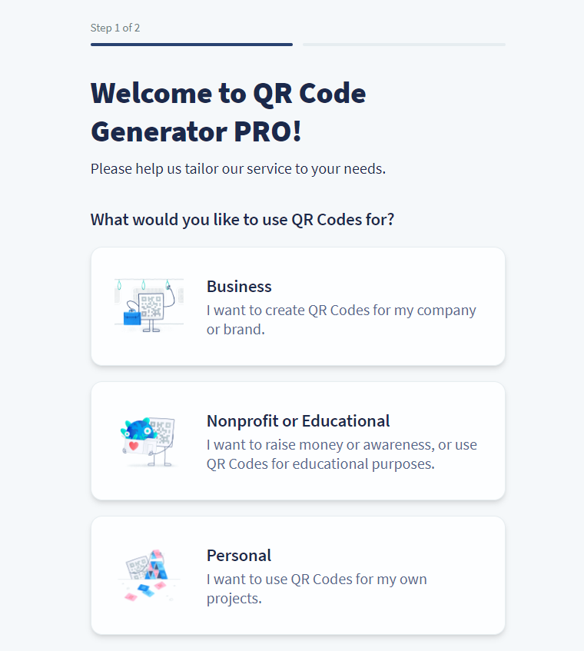
After you sign into the QRcode generator account

Slide 11

After you sign into the QRcode generator account
Click personal ... then Get started

Slide 12
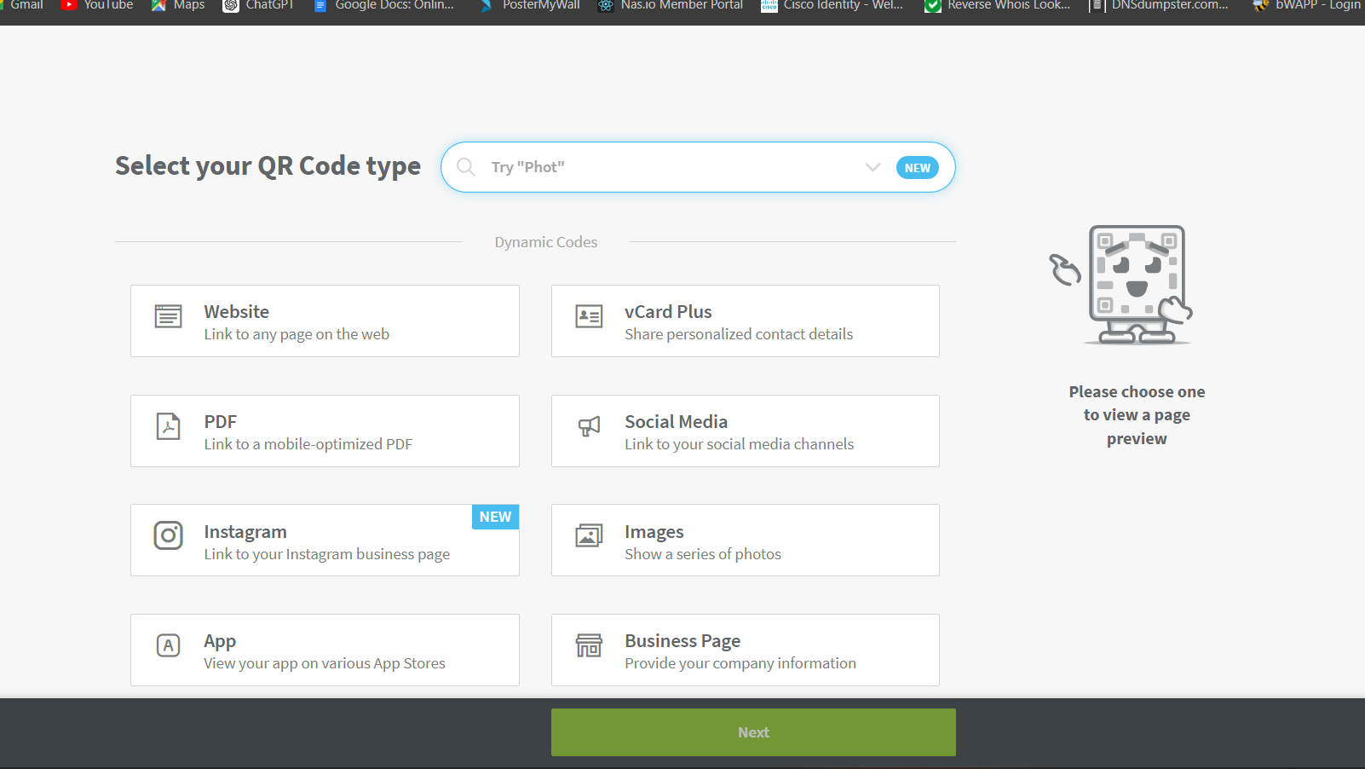
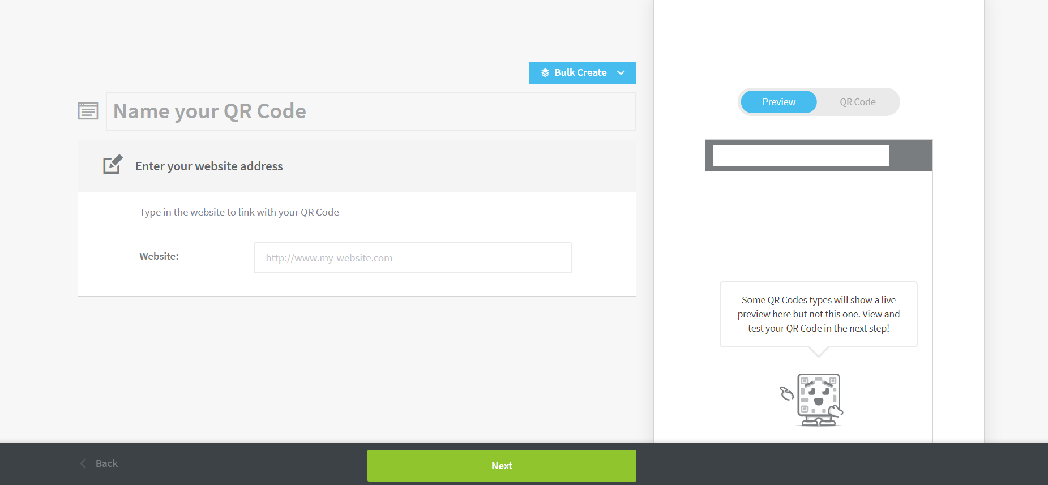
Select website:
Now input the URL into the website column: https://deeboodah.win
Then click next.
Then click next.

Slide 13
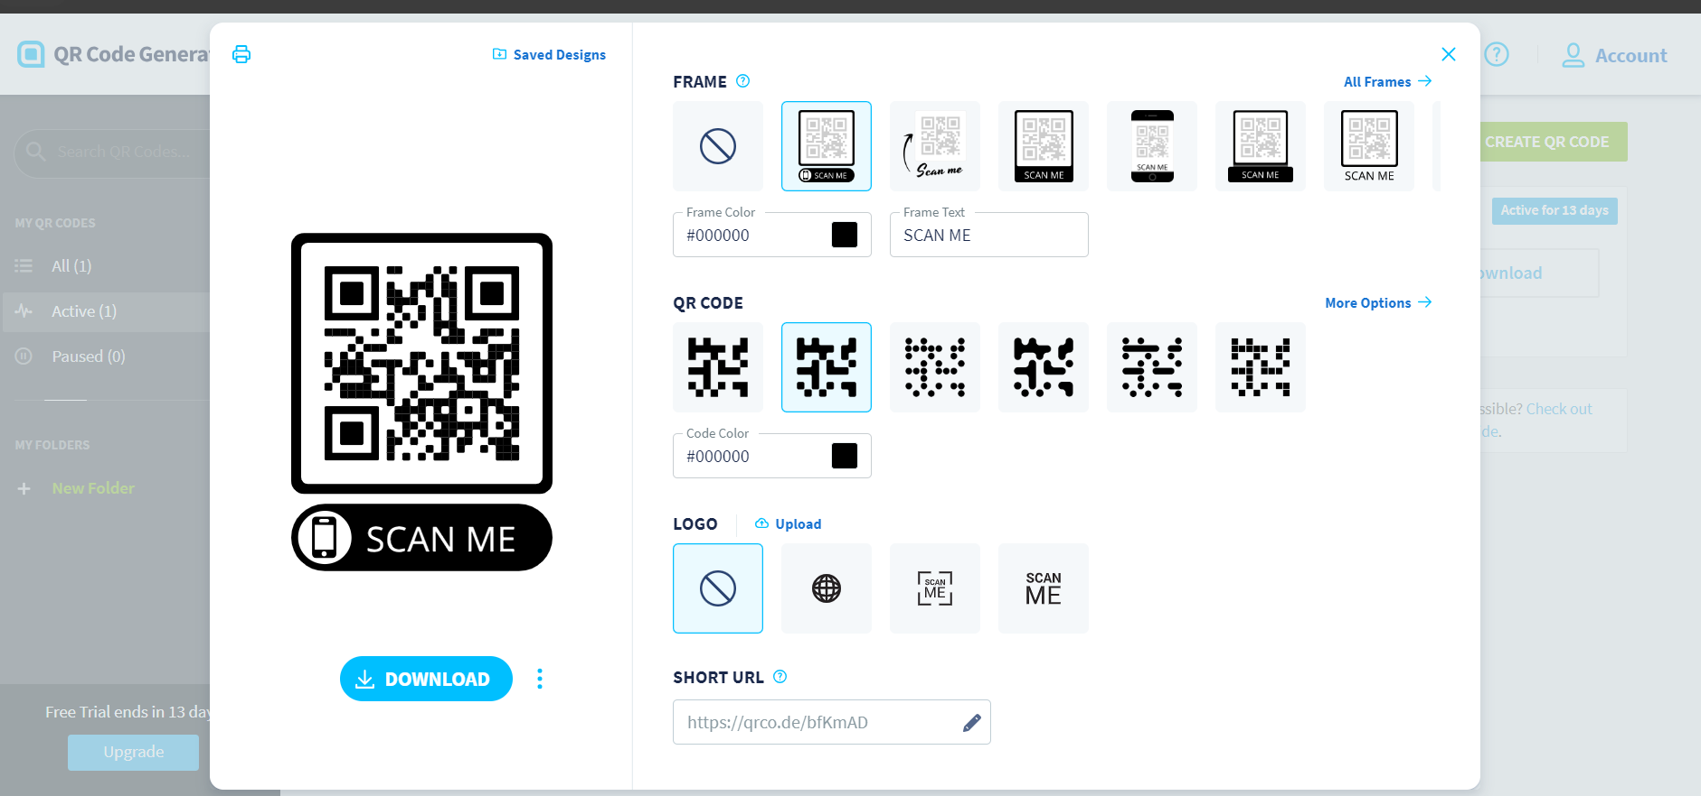
The QR code will generate

Slide 14

Then edit “short url”: click edit it to wiffi-4-free. Or to suit your preference

Slide 15
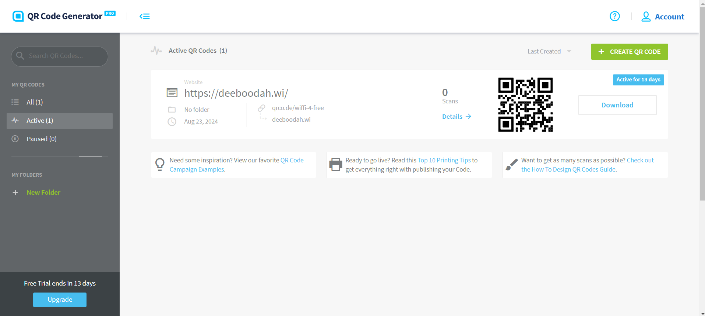
Save and Download the QR code.

Slide 16

Design the downloaded QR code to make it look legit.

Slide 17
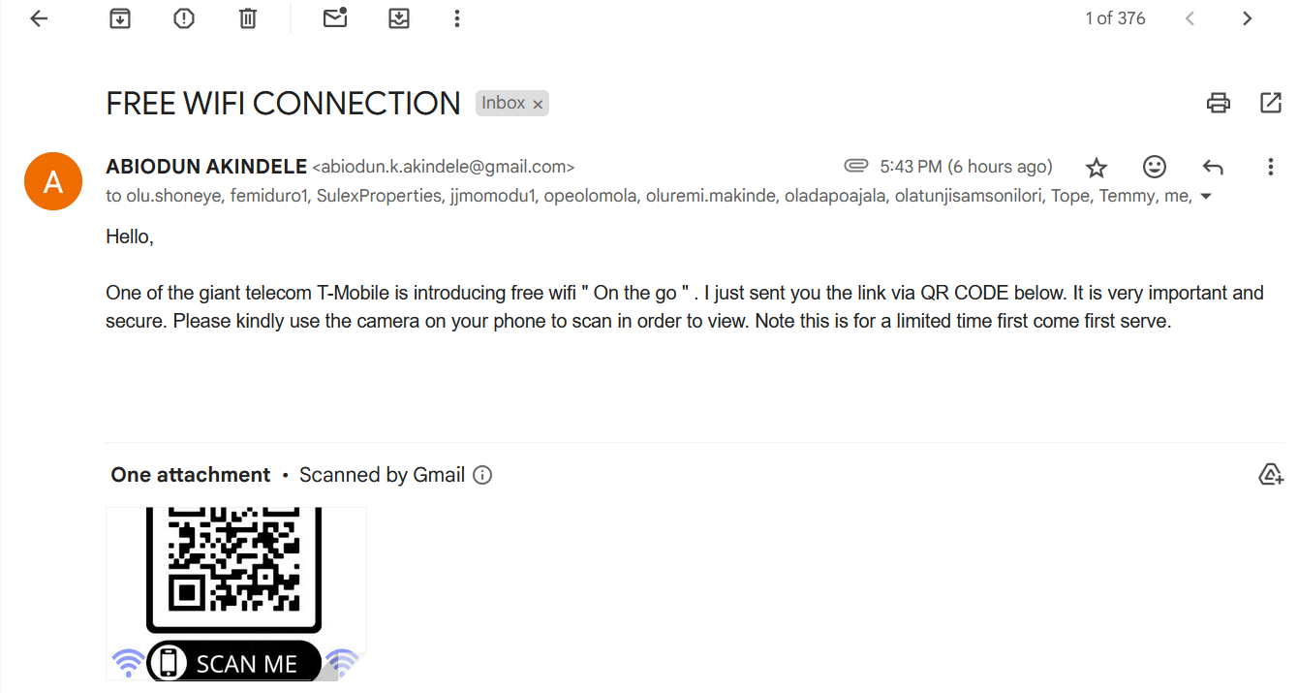
The campaign can be started by sending blast mail, on flyer etc.
Note: Example of the mail received

Slide 18
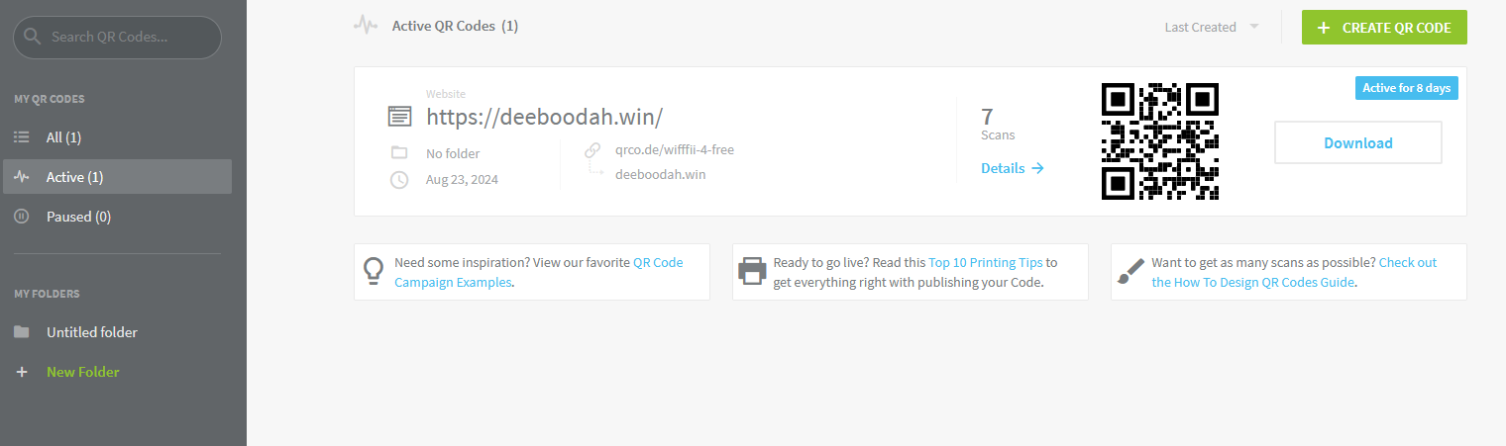
- Go back to QR code generator page. - Go to Dashboard and click on details (to know the number of time the QR code is scanned or link clicked).

Slide 19
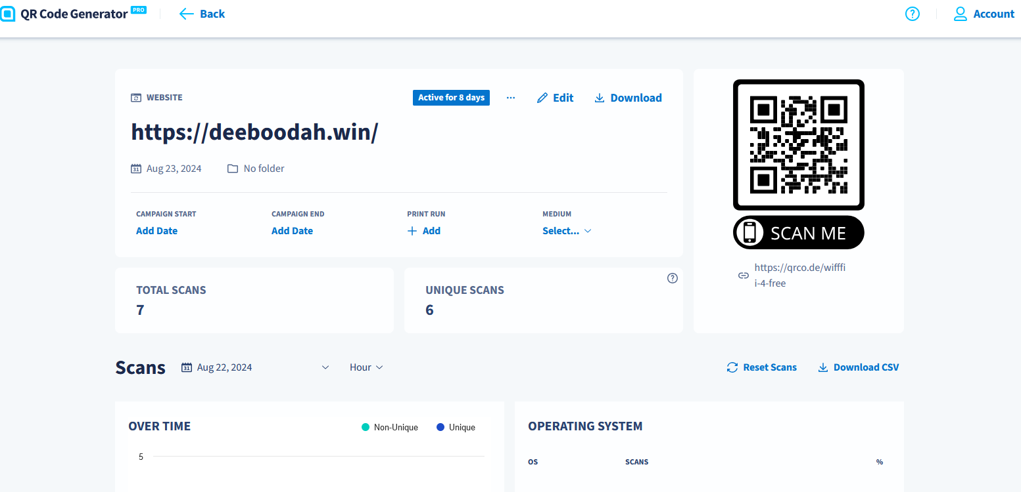
This dashboard shows the QR code has been scanned seven times.

Slide 20
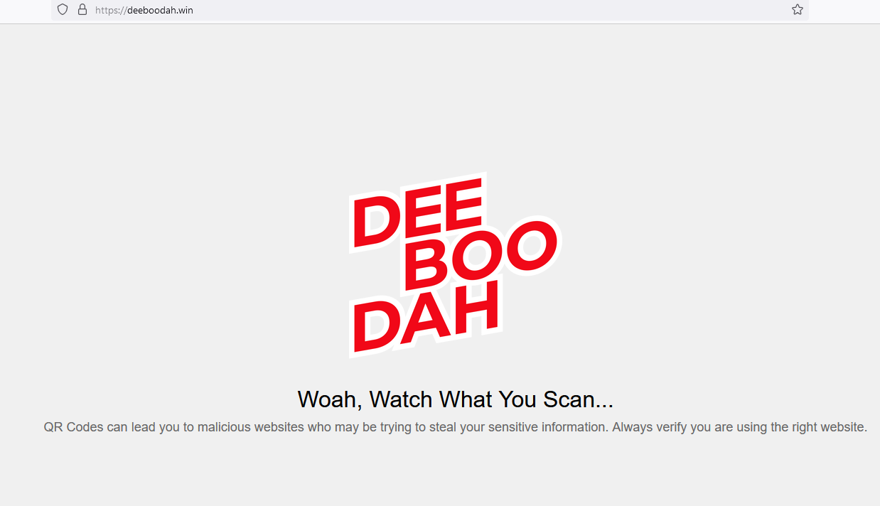
This is the landing page. The Qr code directs people that scan the QR code.

Slide 21
Challenges of Combating Social Engineering and Quishing
Human Vulnerability: Social engineering exploits human emotions like trust, fear, and urgency, making even well-trained employees vulnerable.
Evolving Attack Methods: New techniques, such as Quishing, emerge quickly, making it difficult to keep up with the latest threats.
Widespread Use of QR Codes: The growing popularity of QR codes in legitimate services increases the risk of malicious use without users being aware.
Lack of User Awareness: Many employees and users are unaware of the risks posed by seemingly innocent actions like scanning a QR code.

Slide 22

Motivation Behind Social Engineering Attacks
Financial Gain: Attackers often seek to steal sensitive information, such as bank details, to gain financial rewards.
1
Data Theft: Cybercriminals aim to harvest user credentials, personal information, or trade secrets for exploitation or sale.
3
System Disruption: In some cases, the goal is to disrupt operations, causing downtime and loss of business continuity.
4
Corporate Espionage: Some attacks aim to steal intellectual property or sensitive corporate data for competitive advantage.
2

Slide 23
Resolutions for Mitigating Social Engineering & Quishing Attacks
User Awareness & Training: Regularly educate users on how to identify phishing and Quishing attempts.
Verify Suspicious Links: Always check the source before clicking links or scanning QR codes.
Use Multi-Factor Authentication (MFA): Adds an extra layer of security beyond passwords.
Email Filtering Tools: Deploy anti-phishing tools to filter malicious emails and links.
Mobile Device Security: Protect mobile devices from malicious QR code scanning.

Slide 24





Recommendations for Enhancing Cybersecurity
Ensure
Ongoing Security Awareness Campaigns: Ensure continuous cybersecurity education through workshops, newsletters, and simulations to reinforce awareness.
Conduct
Regular Phishing and Quishing Simulations: Conduct regular tests to assess and improve employee response to these types of attacks.
Promote
Promote Zero Trust Principles: Encourage employees to verify all communications, even if they seem legitimate, and avoid blind trust.
Invest in
Invest in Security Technology: Use tools like secure QR code generators, email filters, and behavioral analytics to detect and block social engineering threats.
Develop
Incident Response Plans: Develop a strong incident response plan to quickly handle and recover from social engineering attacks, minimizing damage.

Slide 25

In Summary
Social engineering, including threats like Quishing, exploits human weaknesses rather than technical vulnerabilities, making it a persistent and evolving threat. As attackers continue to innovate, leveraging trust and convenience, organizations must remain vigilant. Regular training, strong policies, and advanced security tools are essential in mitigating these risks. By fostering a culture of awareness, promoting secure practices, and implementing robust defenses, Apollo can significantly reduce the impact of social engineering attacks and build a resilient cybersecurity posture. Continuous improvement, education, and adaptation will be key to staying ahead of future threats.

Slide 26

Conclusion
Social engineering attacks exploit human vulnerabilities.
Phishing remains one of the most common methods of attack, with variations like Quishing on the rise.
Stay vigilant, verify communications, and promote cybersecurity awareness to defend against these threats.

